Slide 1
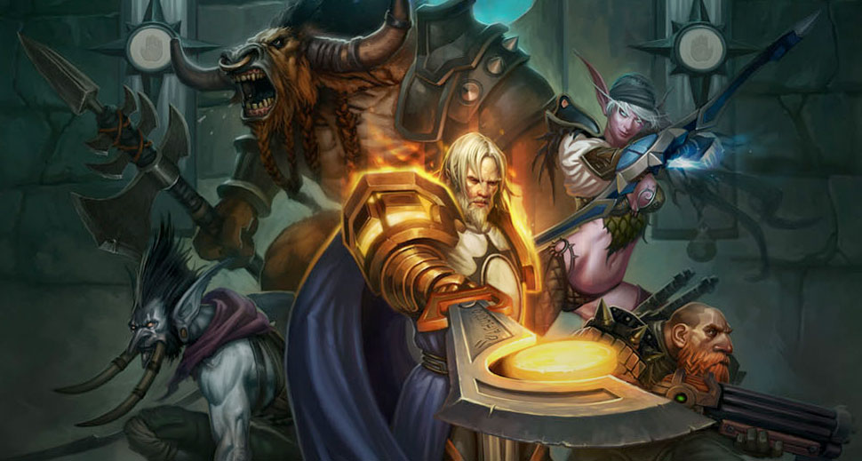
GA 3331 – Game Prototyping
Week 7
Intensity

Slide 2

Hand in homework!

Slide 3
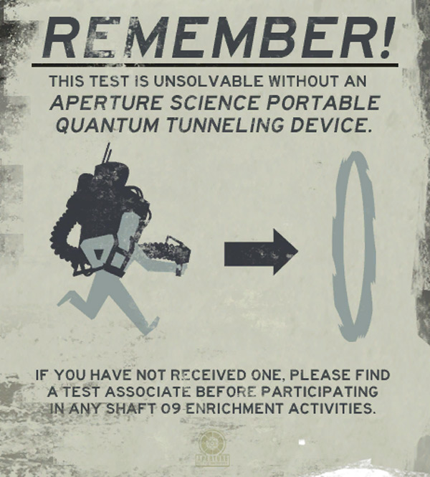
Rules and constraints

Slide 4
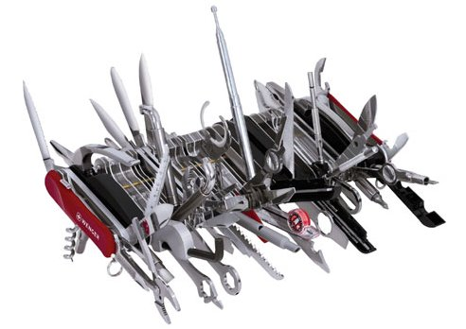
Additive and subtractive design

Slide 5
Why Add mechanics?
Note, this can be very costly
Ideally, you know about all the mechanics before they enter production, but this doesn't always happen
Publisher demand (they give you the moneyz)
Changes in the marketplace
The game sucks
You're making a sequel
The brainstorm

Slide 6
Why remove mechanics?
This can be VERY costly as well
Publishing
Marketing conditions
Fixing bad gameplay
Ratings
Delivering on or in better time
Checking features against the core checklist

Slide 7
Lab - Challenges
Pick a game that you consider to be terrible. Have another team subtract or add one mechanic that improves it
Take a 2 player video game and convert it to be playable by four players
Choose an E rated game, and add a mechanic that will bump it to Teen, and Mature
Have another team pick two mechanics (Choose from the list), and add it to your game.
Redesign a game by removing a mechanic (the publisher didn’t want it)

Slide 8
Game intensity
Movies
Predicting intensity
Movie Structure
TV Structure
Game structure

Slide 9
Fulfillment and Rewards
http://www.gamasutra.com/blogs/MickeyBlumental/20130131/185858/10_Ways_to_Retain_Your_Players.php
http://www.gamasutra.com/view/feature/134246/reward_systems_an_excerpt_from_.php?print=1
http://www.gamasutra.com/view/feature/3085/behavioral_game_design.php

Slide 10
The “Farmville” effect
http://www.gamasutra.com/blogs/MarkNewheiser/20091204/3733/Farmville_Social_Gaming_and_Addiction.php

Slide 11
The Learning Curve
Mastery and Exploration
Street fighter 4
Starcraft 2
COD: MW
Mario kart

Slide 12
Lab – Capture the flag
Lab – Modding capture the flag

Slide 13
Homework

